Slide 1


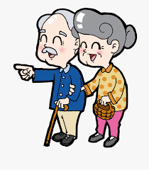

Slide 2
THE TEAM
Team Members
Avinash Peruboina
Ayushi Nayak
Hassan Yaqoob
Geetika Agarwal
Vaibhav Gala
Project Coordinators
Andrea Curley
Damian Gordon
Paul Kelly

Slide 3




Healthcare is a social good
Accessibility of healthcare applications.
Supporting hands in times of need.
Tackling healthcare inequalities.

Slide 4




Project Vision
Reliable healthcare platform
Self diagnosis tool
Home remedies manage.
List of doctors nearby.
Build a community.
Notes:
Aim to provide a reliable platform for users to track their health on the go.
The users should be able to self diagnose and manage their symptoms until they can get professional heath.
To provide the users a list of doctors whom they can contact if they need to.
Aim to build a community where no one must worry about being alone in times of need.

Slide 5
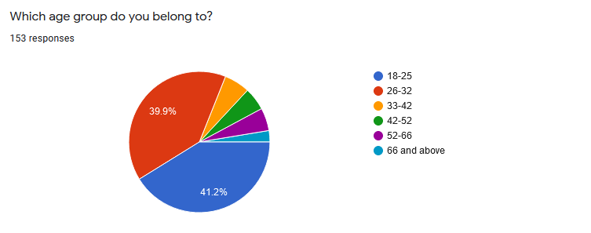
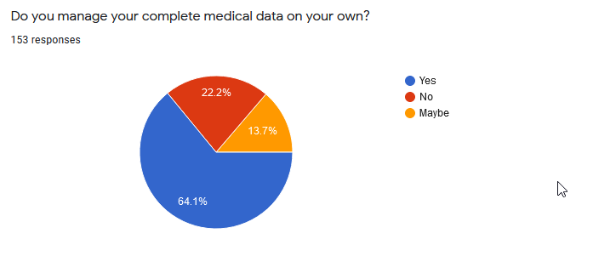
Target Personas
Age group of users
Number of people who needs management of medical record

Slide 6
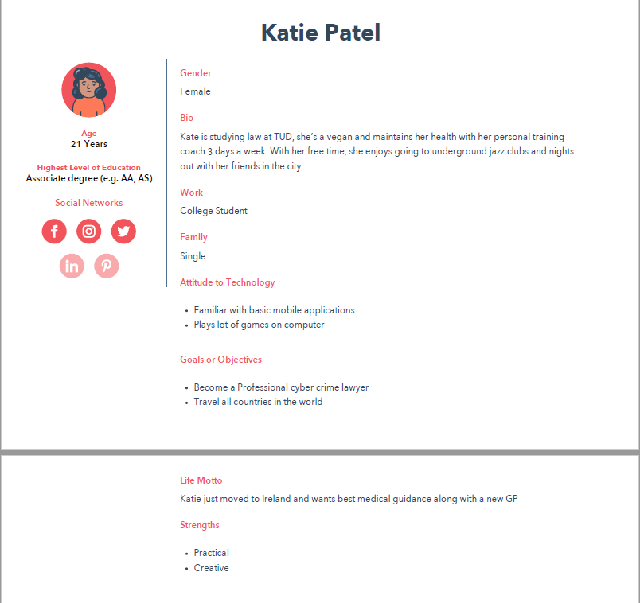
USER PERSONAS

Slide 7
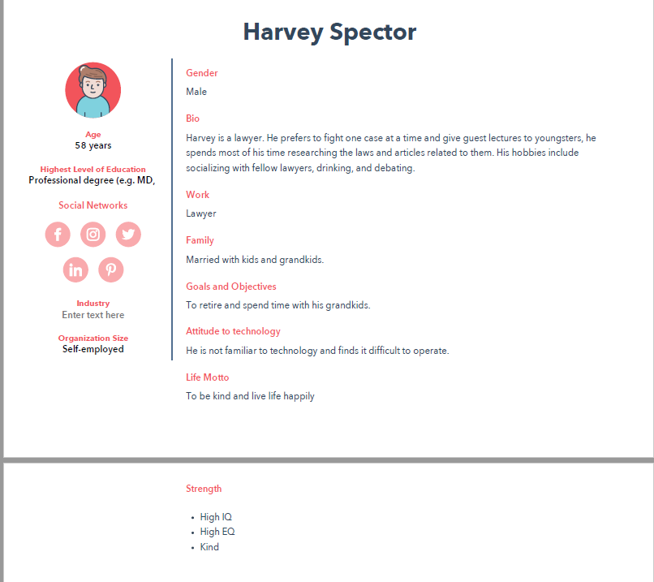
USER PERSONAS

Slide 8
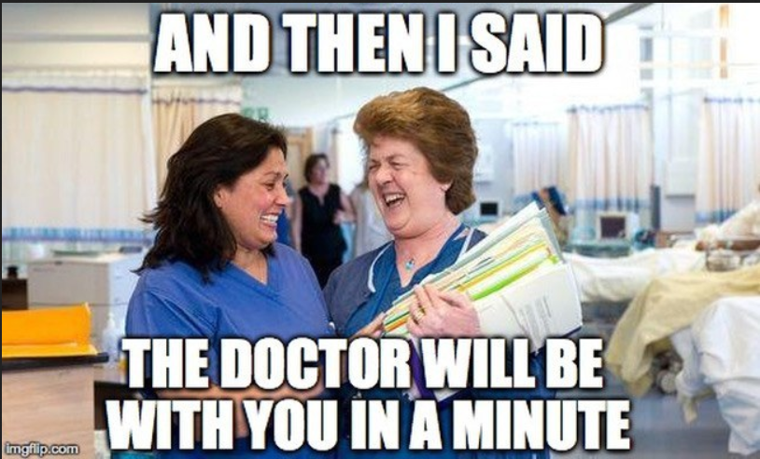
Technical Problem

Slide 9


Existing Products vs Haley
Functionalities | ADA HEALTH | WEB MD | HEALTHLINE | JustANSWER | HALEY
Historical Symptom tracking
Symptom Diagnosis
Easy to use
Web application
Mobile application/ can be accessed on smartphones
Home remedy recommendation
Guest Login
Notes:
THis needs to change, the alst point

Slide 10
Innovation Matrix
Well Defined
Breakthrough Innovation Building a community around a health monitoring app. | Sustaining Innovation Creating a health assessment app for the current Irish market.
Basic Research Considering common systems as a source of a pandemic. | Disruptive Innovation Protecting users from misleading diagnosis usually is driven by SEO focused websites.
Not Well Defined
Problem Definition
Not Well Defined
Well Defined
Domain Definition

Slide 11
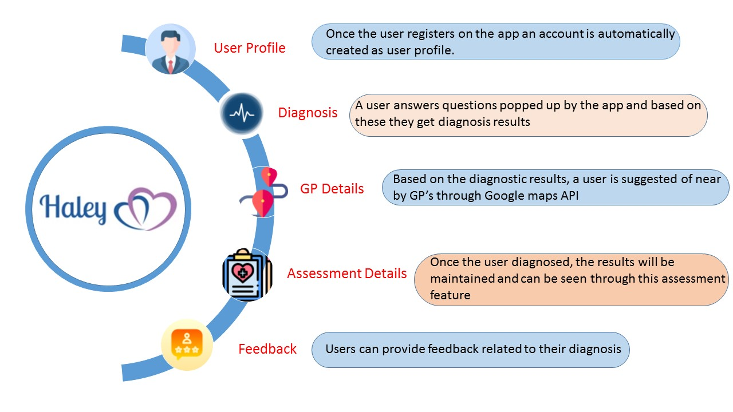

Technical Solution
Functional Requirements

Slide 12



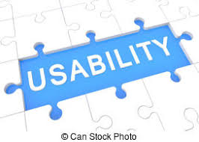
Technical Solution
Non-Functional Requirements

Slide 13
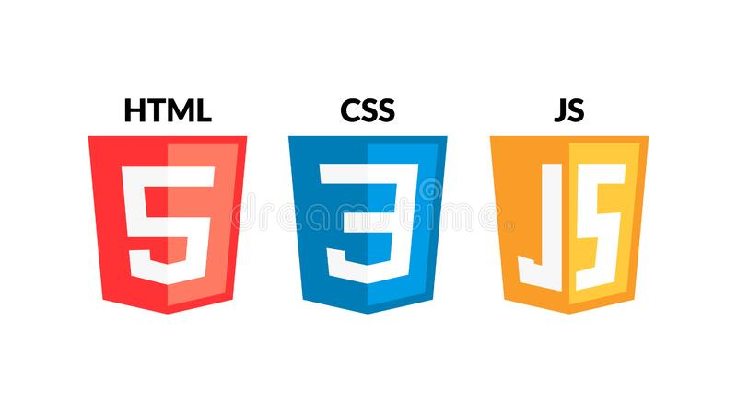





Technology Stack

Slide 14







Tools Used

Slide 15
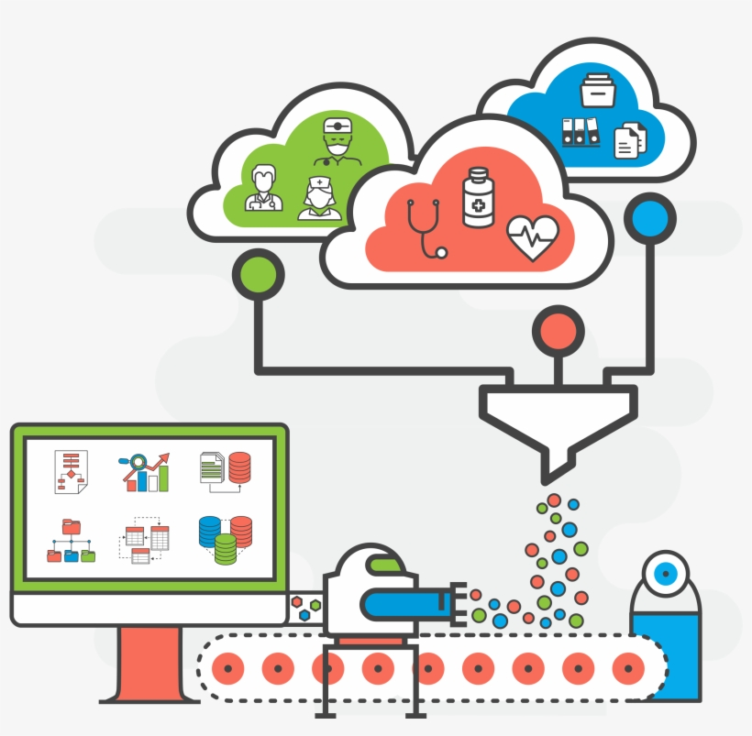
Data

Slide 16

CRISP-DM

Slide 17












Data Collection

Slide 18
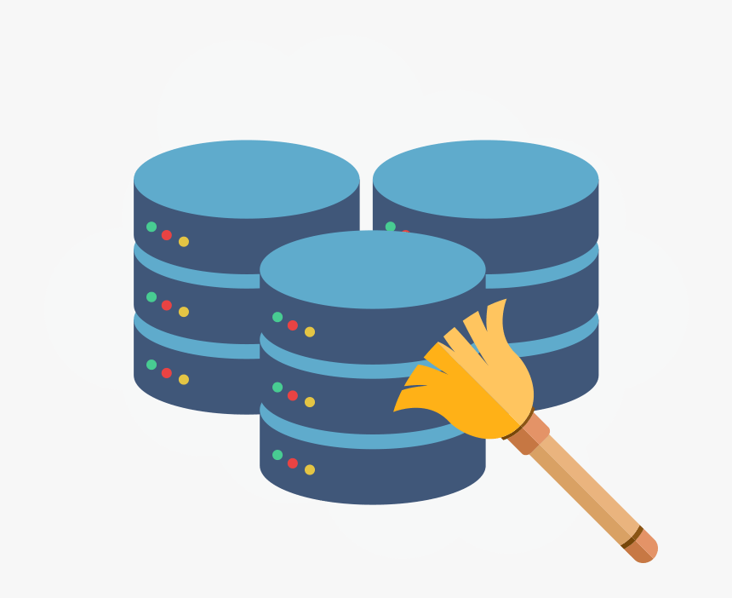
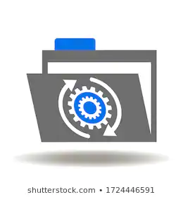


Data Synthesizing
Step 1- Data Cleaning
Step 2- Information Extraction
Step 3- Research on synthesizing techniques
Step 4- Synthesize Data using java

Slide 19
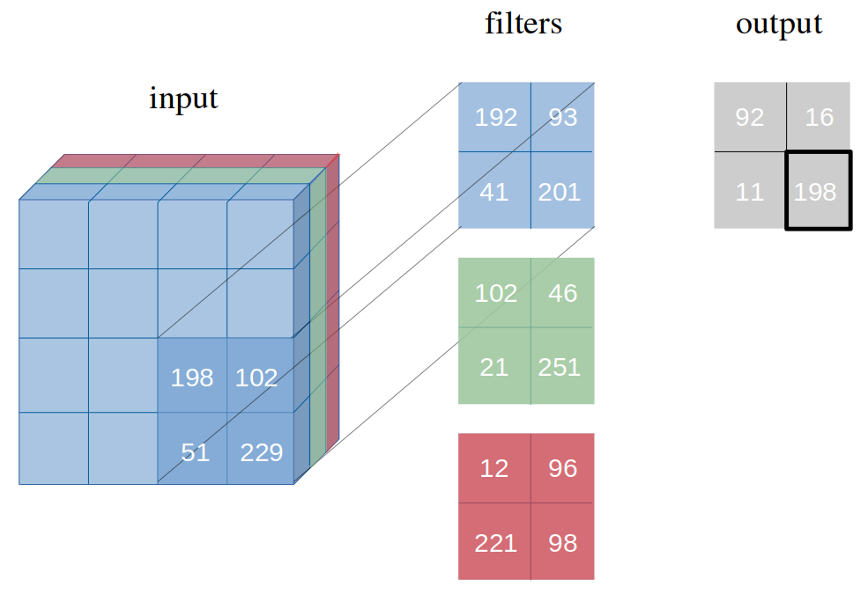
Proposed Model
Network with point estimates https://arxiv.org/pdf/1806.05978.pdf

Slide 20


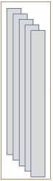
Network Structure
Input Sequence
Convolution Layer
Convolution Layer
Convolution Layer
100 x Feature maps
Activation Layer
200 x Feature maps
300 x Feature maps
100x1x3 Kernels
200x1x3 Kernels
300x1x3 Kernels
Relu
Fully Connected Layer (1 x 1000)
Fully Connected Layer (1 x 34)
Structure for the proposed 1D-CNN Network

Slide 21
Technical Challenges
dsg
UI Challenges
Diagnostic Tool /Results
Google maps API (GP Feature)
Deployment
Providing multiple diagnosis for a single input
Implementation of Bayesian CNN
Notes:
Mention how we resolved the challenges. More time and focus on these (!!ATT) !!MVP slide

Slide 22
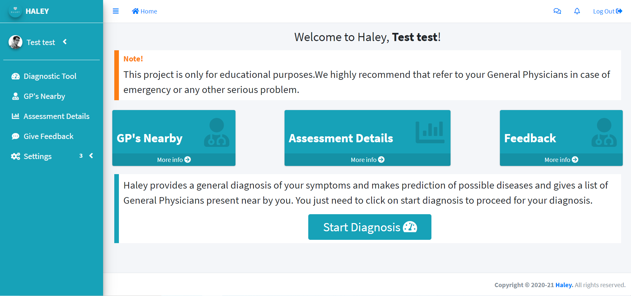
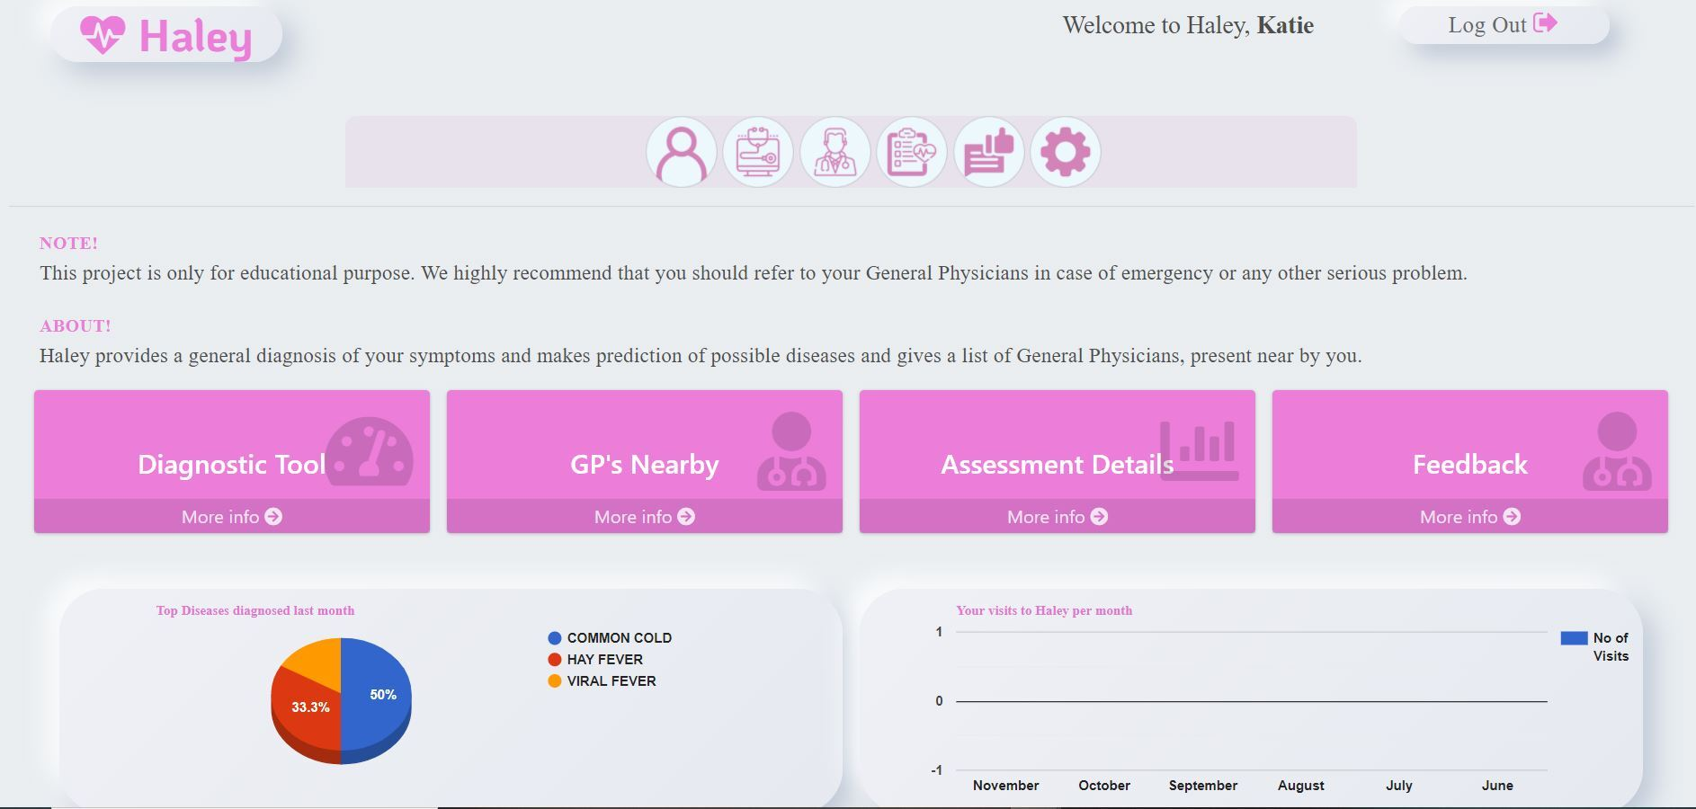
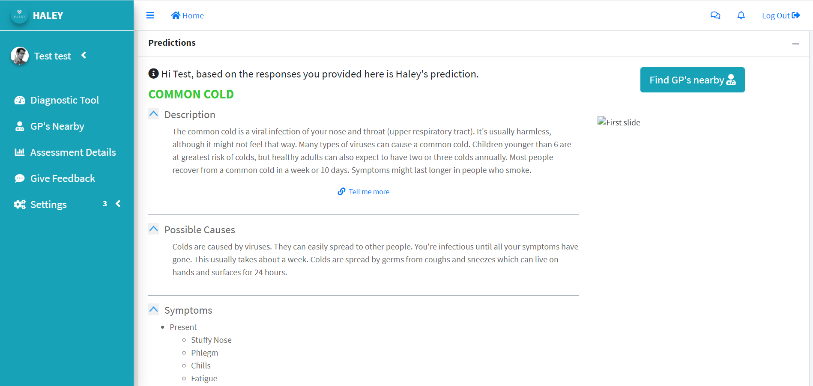
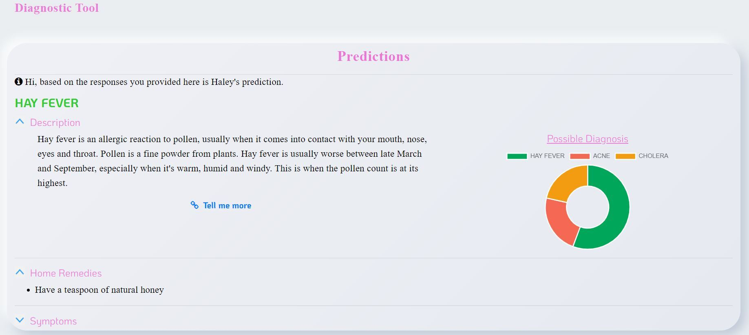
User Home Screen, Second Release
User Home Screen, Final Release
Haley Prediction Second Release
Haley Prediction Final Release

Slide 23
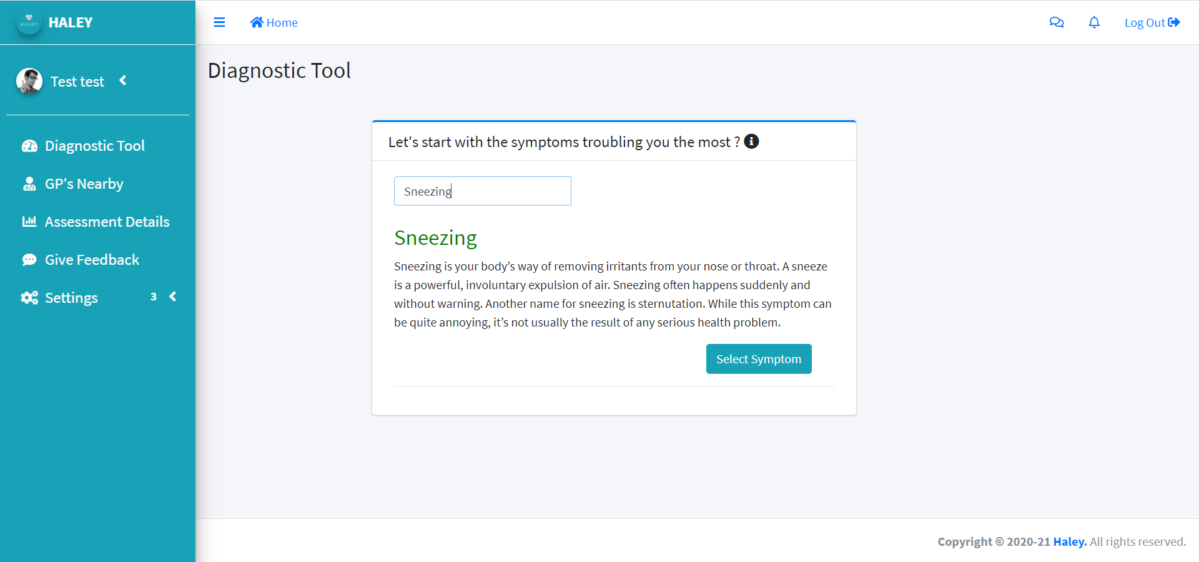
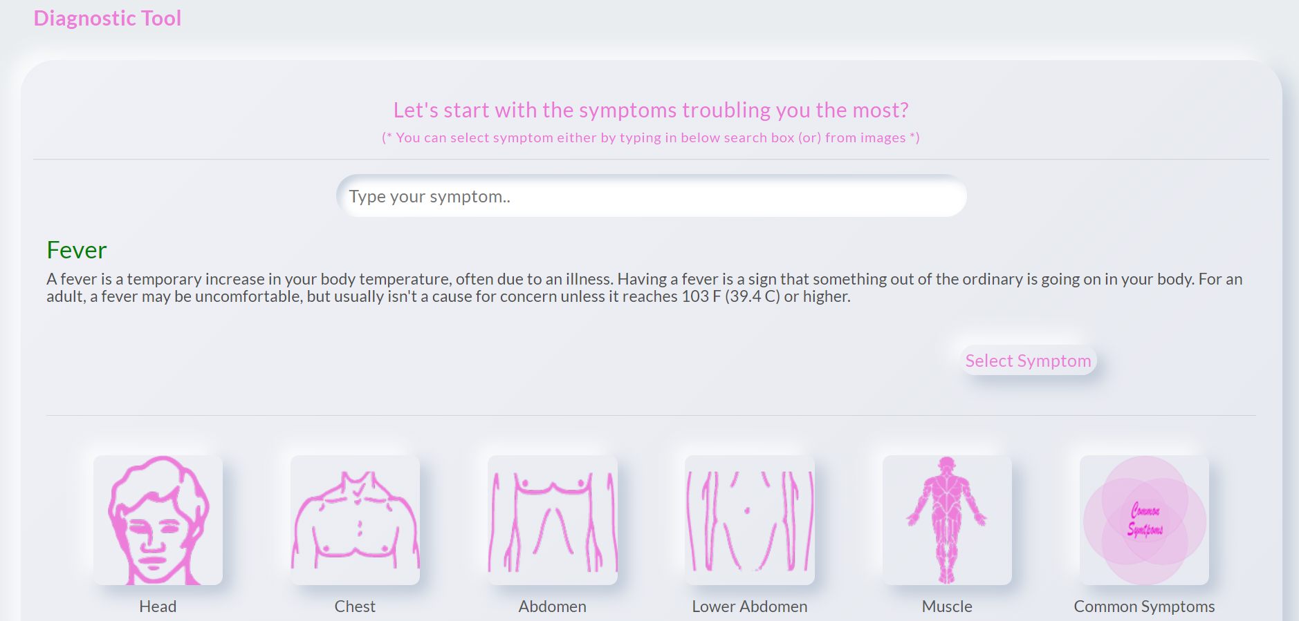
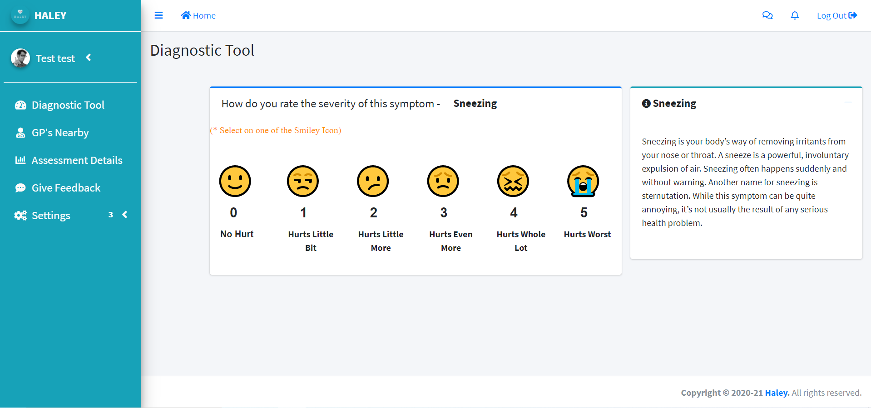
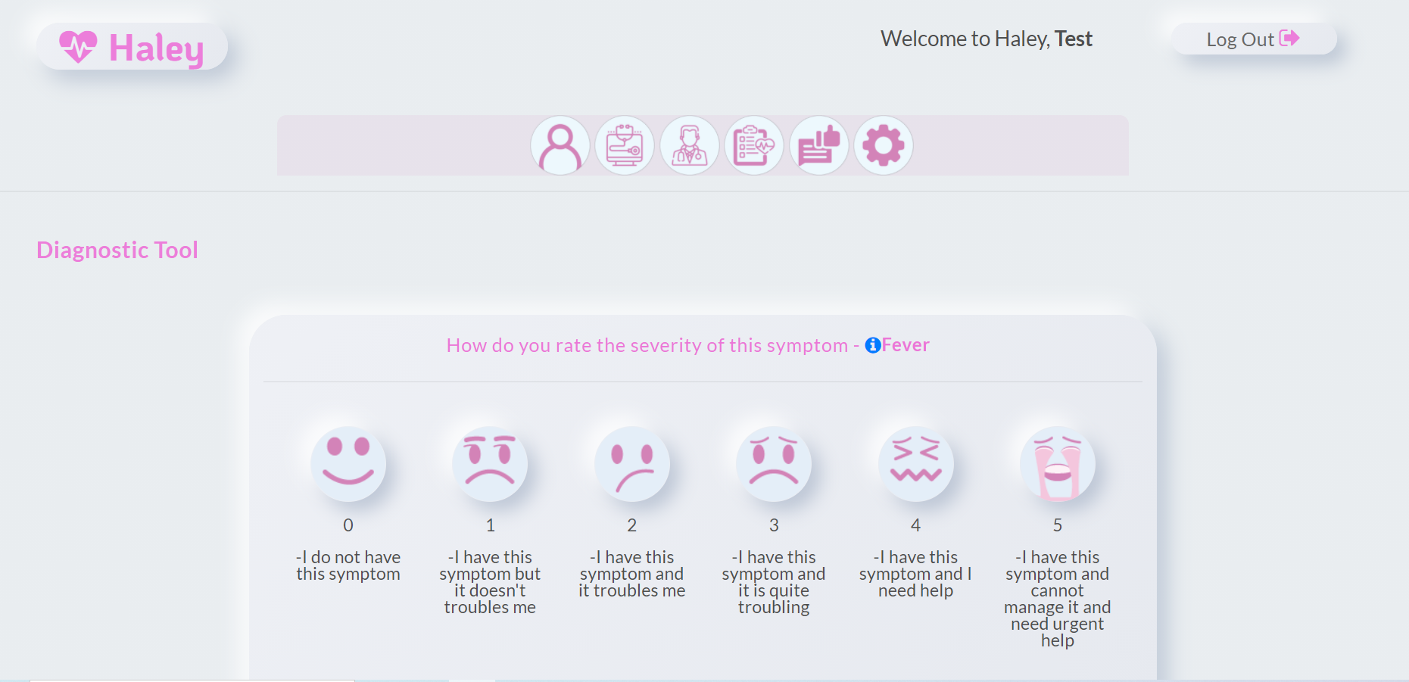
Diagnostic tool, Second Release
Diagnostic Tool, Final Release
Diagnostic Tool, Second Release
Diagnostic Tool, Final Release

Slide 24

Evaluation/ Testing
dsg

Slide 25
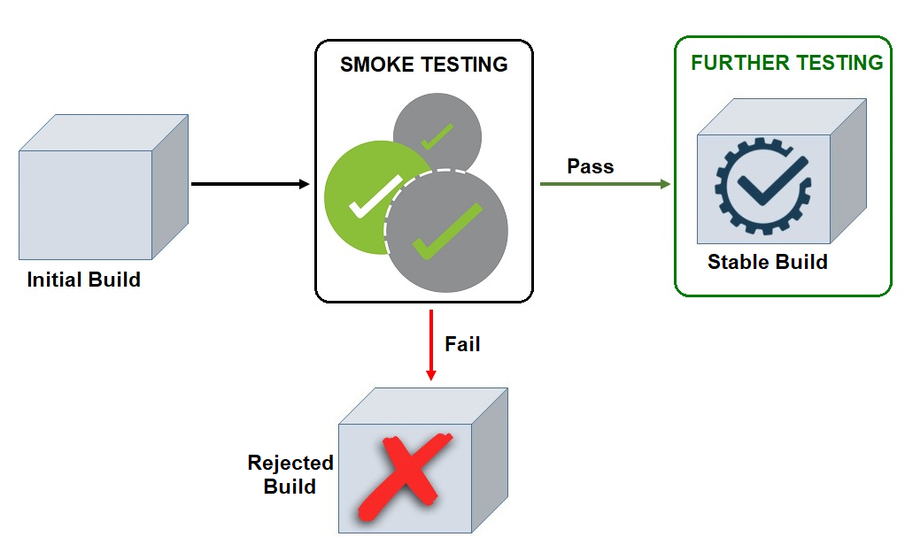
Smoke Testing
Notes:
Also known as unit testing, did for every version release of the project went through 103 builds.

Slide 26
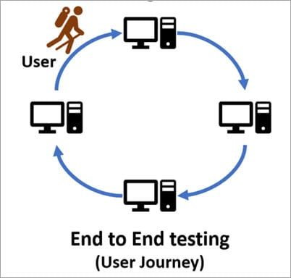
User Acceptance Testing
dsg

Slide 27
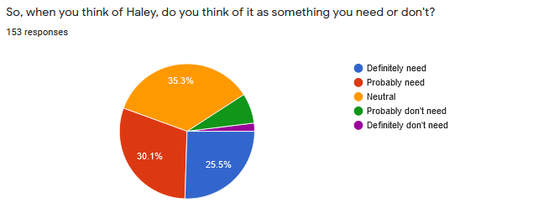
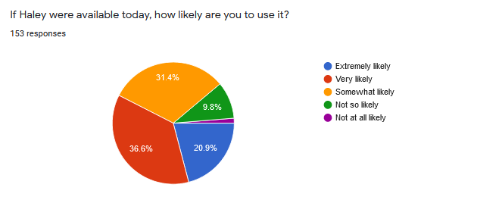
User Evaluation
(Initial Release)

Slide 28

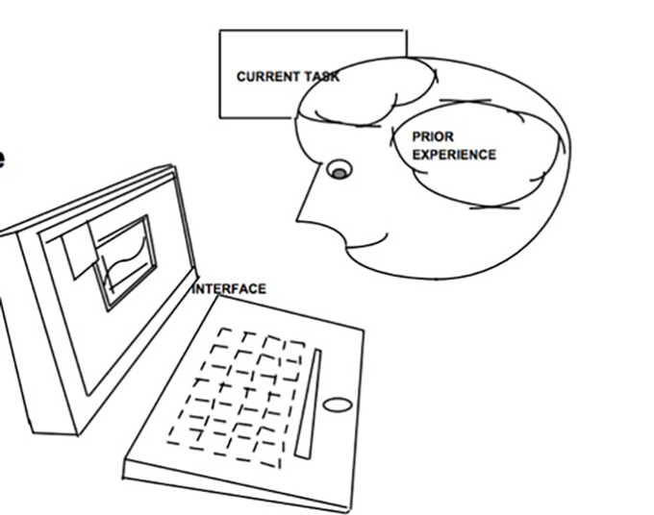

User Evaluation
(Second Release)
Methods
Cognitive walkthrough
Questionnaire

Slide 29
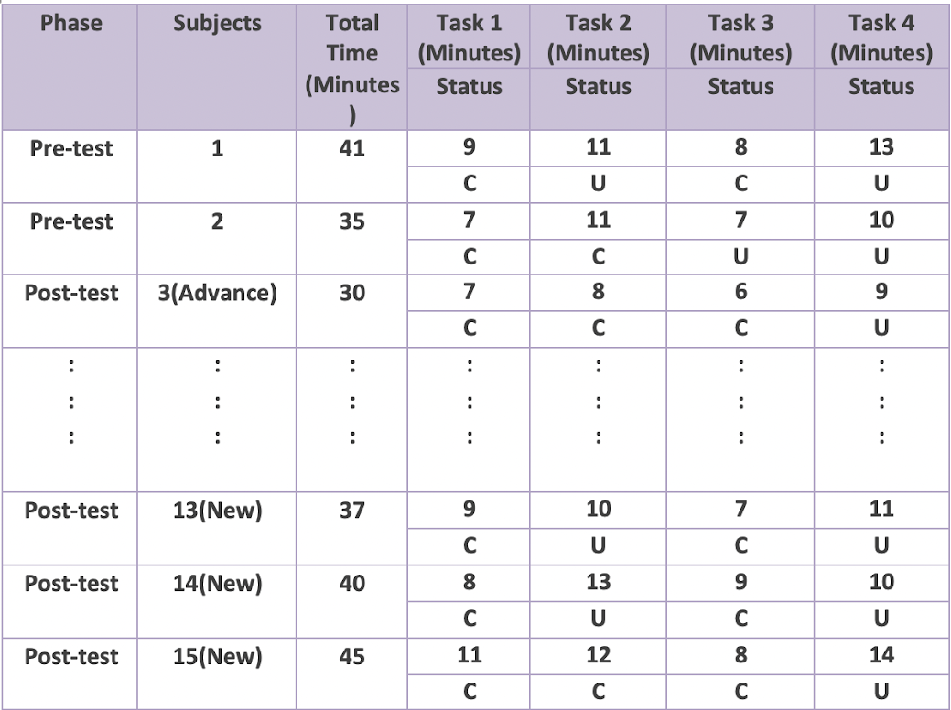
Data Analysis
Summary of Task's duration and its status

Slide 30
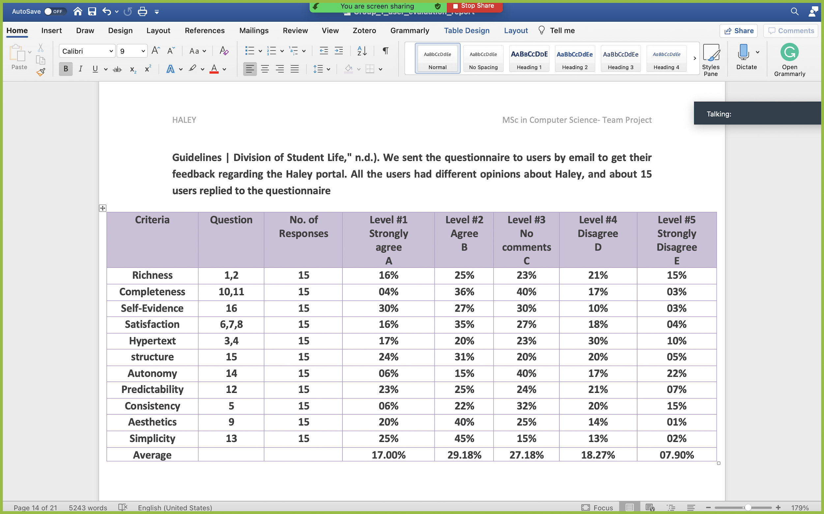
Data Analysis
Response of users

Slide 31
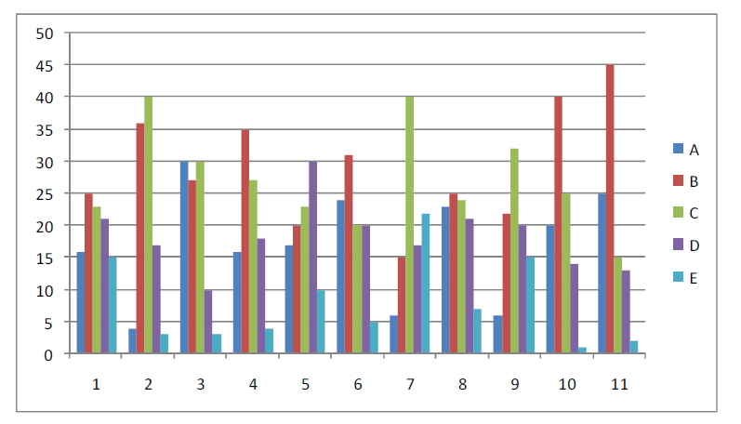
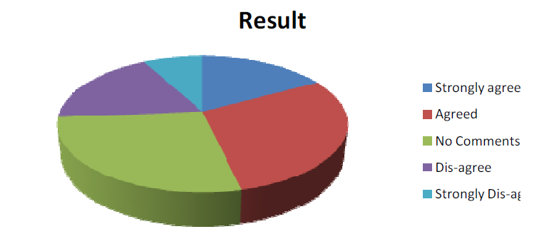
Questionnaire Results
Graphical representation of users’ response
Overall result of the questionnaire

Slide 32
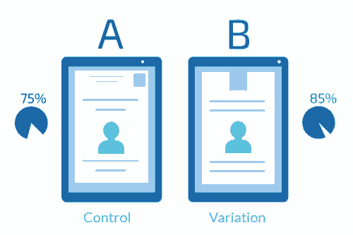
User Evaluation
(Final Release)
Methods
Survey
Questionnaire
A/B Testing

Slide 33


Second Release vs Final Release
Features | 2nd Release (Previous) | Final Release (Latest)
Ease of Use
Guest Login
Completeness
Consistency
Simplicity
Self Evidence
Completeness
Satisfaction
Memorability
Mobile Version

Slide 34



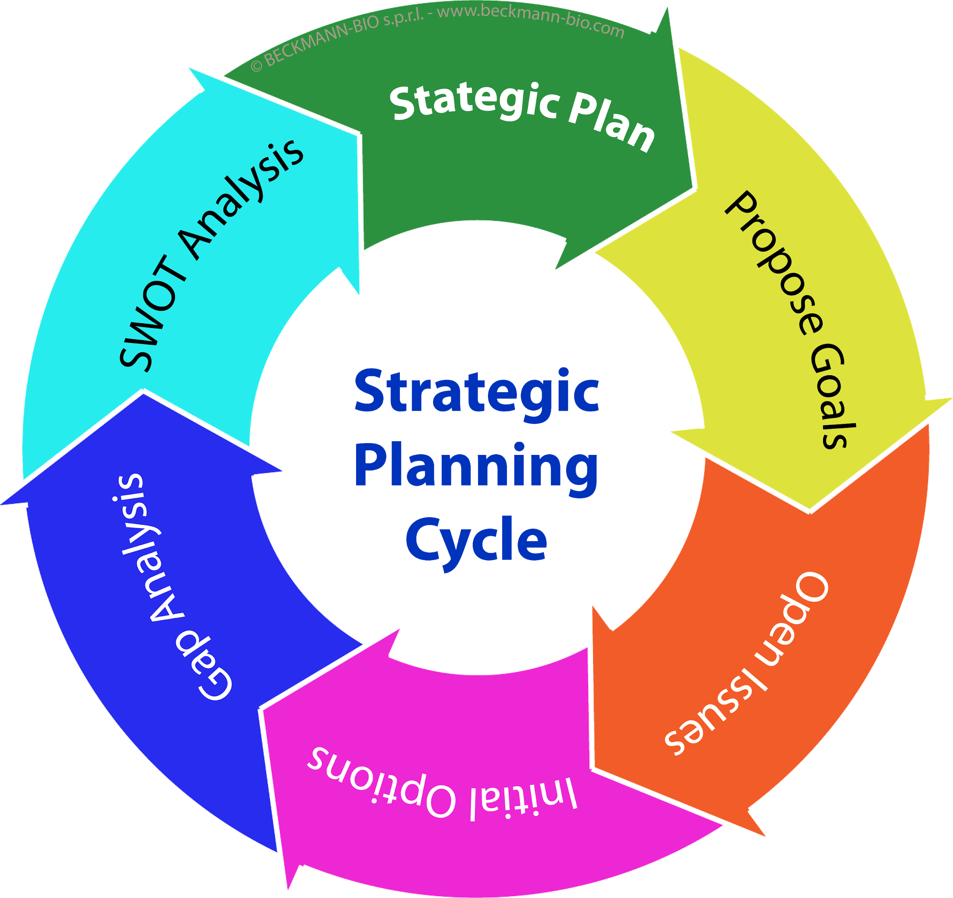
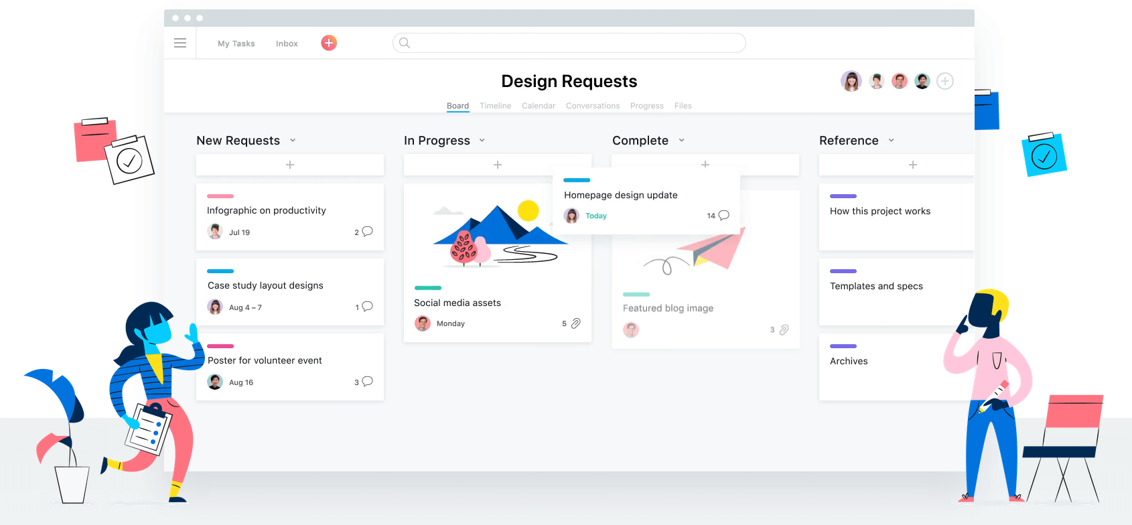
Project Management
Input from stakeholders
The Team

Slide 35
The System Review
Does your system solve the problem you set out to address?
Yes
What are the outstanding problems?
Not Global
What would you do next to improve the system?
Space (MongoDB)
Personalised secured vault for storing medical documents and bills.

Slide 36
Analysis
The system is easily scalable.
The system is user friendly and easily usable
The NN model success rate
The system is secure

Slide 37
Limitations
Scope of the project– Covered 34 diseases.
Google App Engine memory limitation to 1GB.
Google maps API limited calls.

Slide 38
Success
Technology success
Features success
Team success
Users success
Notes:
Technology success -
Understanding of python, Django, jQuery and all the other technologies used.
Features success-
Implementing all the features initially defined by the team.
Team success-
Working well together, adhering to timelines, and harmonious interaction between the team members.
Users success-
Good user interaction with the application, ease of access, interactive and attractive user interface, and total control on personal data stored in the application at any point of time

Slide 39
Conclusion A.K.A Learnings
•How did you work together as a team?
By motivating each other to work with more focus and enthusiasm.
Resolving Conflicts/issues at the moment as a group and helping each other grow.
•What lessons have you learned from this project?
Respect each other’s quirks.
•What would you do different next time?
Make the requirements more specific at initial stages.

Slide 40
Liked - Devoted member and team level concern for a common cause - Successfully able to deliver the functionality - Help received from mentors and members of the other teams. | Learned - Team Work - In-depth understanding of technologies used - How to work in fast-paced Agile development - How to make UI presentable - Importance of feedback loop - How to work with GitHub and ZenHub
Mad - Frustrating number of errors we encountered during development and deployment - No face to face interactions - Overhead on API calls | Longed For - More time for development - A range of free tools that we can use for deployment -More RAM, Storage and higher processing speed.

Slide 41
References
(PDF) Usability of health web sites for older adults: A preliminary study. (n.d.). Retrieved November 17, 2020, from https://www.researchgate.net/publication/8128206_Usability_of_health_web_sites_for_older_adults_A_preliminary_study
5 Usability Design Tips For A Better User Experience Design. (n.d.). Retrieved November 17, 2020, from https://www.invespcro.com/blog/usability-design-for-a-better-user-experience/
Being Predictable: The First Essential of a Customer-Centric Business | UX Magazine. (n.d.). Retrieved November 17, 2020, from https://uxmag.com/articles/being-predictable
Consistency — A Key Design Principle | by Saadia Minhas | Prototype. (n.d.). Retrieved November 17, 2020, from https://blog.prototypr.io/consistency-a-key-design-principle-5d125469da8e
Executive, N. H. S., Strategy, A. I., Nhs, M., Executive, N. H. S., Core, I., Plan, N. H. S., … Plan, N. S. (2005). Evaluating Models of Health Service Delivery of E-Health Strategies To Meet the Aims of the Nhs and the. 2005(September 1998).
Granić, A., Mitrović, I., & Marangunić, N. (2008). Usability evaluation of web portals. Proceedings of the International Conference on Information Technology Interfaces, ITI, 427–432. https://doi.org/10.1109/ITI.2008.4588448

Slide 42
References
How to Incorporate Accessibility in Your Website. (n.d.). Retrieved November 17, 2020, from https://www.searchenginejournal.com/make-website-more-accessible/347450/
Hypertext - an overview | ScienceDirect Topics. (n.d.). Retrieved November 17, 2020, from https://www.sciencedirect.com/topics/computer-science/hypertext
Rozmovits, L., & Ziebland, S. (2004). What do patients with prostate or breast cancer want from an Internet site? A qualitative study of information needs. Patient Education and Counseling, 53(1), 57–64. https://doi.org/10.1016/S0738-3991(03)00116-2
Sillence, E., Briggs, P., Fishwick, L., & Harris, P. (2004). Trust and mistrust of online health sites. Conference on Human Factors in Computing Systems - Proceedings, 663–670. https://doi.org/10.1145/985692.985776
Sillence, E., Briggs, P., Harris, P., & Fishwick, L. (2006). Changes in online health usage over the last five years. Conference on Human Factors in Computing Systems - Proceedings, 1331–1336. https://doi.org/10.1145/1125451.1125698
Stepanovich, P. L., & Uhrig, J. D. (1999). Decision making in high-velocity environments: Implications for healthcare. Journal of Healthcare Management, 44(3), 197.

Slide 43
References
Tahir, U., & Mushtaq, A. (2015). Measuring User Satisfaction through Website Evaluation Framework. International Journal of Knowledge Engineering-IACSIT, 1(2), 125–128. https://doi.org/10.7763/ijke.2015.v1.21
The Illusion of Completeness: What It Is and How to Avoid It. (n.d.). Retrieved November 17, 2020, from https://www.nngroup.com/articles/illusion-of-completeness/
Usability Guidelines | Division of Student Life. (n.d.). Retrieved November 18, 2020, from https://studentlife.mit.edu/wellness-and-support/accessibility-usability/usability/usability-guidelines
What is Aesthetics? | Interaction Design Foundation (IxDF). (n.d.). Retrieved November 17, 2020, from https://www.interaction-design.org/literature/topics/aesthetics
Why Simplicity Is So Incredibly Important In UX Design. (n.d.). Retrieved November 17, 2020, from https://careerfoundry.com/en/blog/ux-design/how-important-is-simplicity-in-ux-design/
Share and Discover Knowledge on SlideShare (no date). Available at: https://www.slideshare.net/

Slide 44
Demo Link
https://github.com/GroupProjectSem3/Haley/tree/master/Documentation/Final%20Demo

Slide 45

THANK YOU
ANY QUESTIONS PLEASE?

